Slide 1



Audio classification
Predicting song genres
Notes:
For my third capstone I decided to work with audio data and try to predict song genres.

Slide 2

Audio and machine learning
Audio data increasing in importance
Virtual assistants
Self-driving cars
Music recommendation for radio channels
Notes:
Audio data is quickly becoming an important part of machine learning. We’re using it to interact with virtual assistants like Alexa or Siri and helping self-driving cars hear their surroundings rather than just seeing them. Music has been a part of my life ever since I started playing my first instrument when I was 4 years old so I really wanted to use a neural network and see if it could learn to distinguish different types of music.

Slide 3

Data source
Free Music Archive
FMA small + metadata
8,000 tracks with 8 genres
Electronic
Experimental
Folk
Hip-Hop
Instrumental
International
Pop
Rock
Notes:
The data I used for this project was the free music archive. It contains up to 106,000 tracks with 161 unbalanced genres, but in the interest of time I decided to work with the small dataset which only has 8 genres and 8,000 30-second tracks evenly distributed for each genre. The genres in this set were Electronic, Experimental, Folk, Hip-Hop, Instrumental, International, Pop, and Rock.

Slide 4

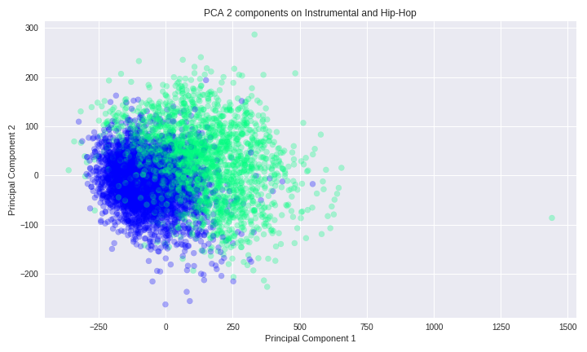
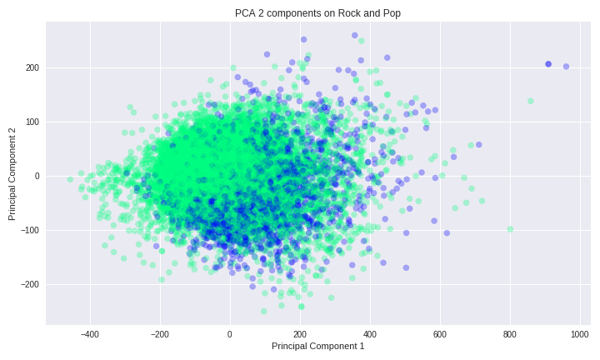
Principal component analysis
Notes:
When first looking at the data I did some PCA down to 2 dimensions in order to plot and get a sense of how these genres would compare to each other. With Instrumental and Hip-Hop I could see the separation, but with Rock and Pop it would prove a lot tougher to predict one way or the other.

Slide 5
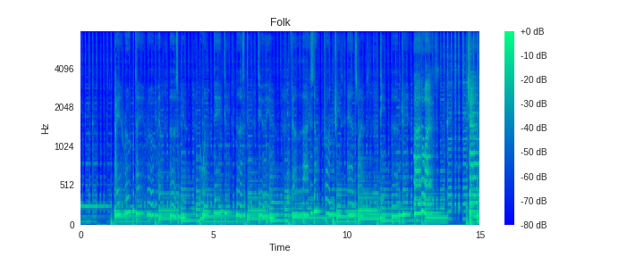
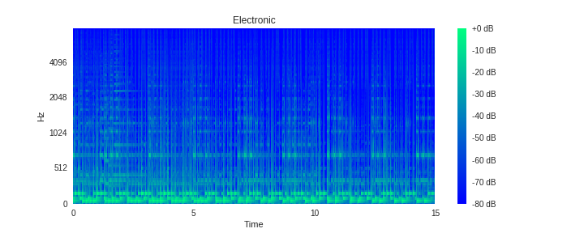
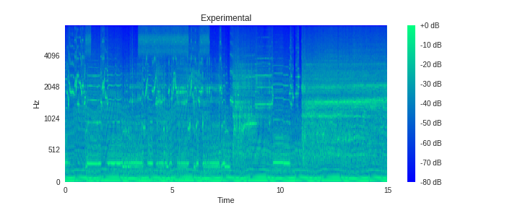
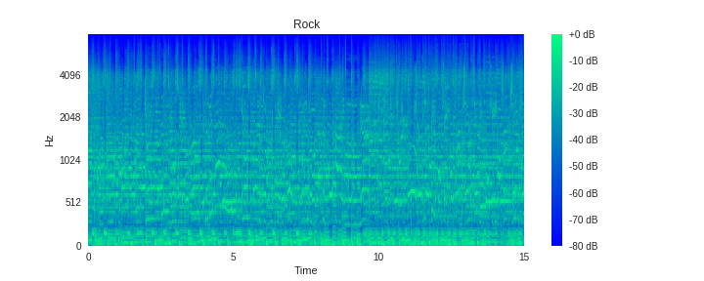
Mel Spectrogram
Notes:
Since I was dealing with audio data I knew I wanted to look at spectrograms as a visual representation of frequencies over time. I used librosa to squash a regular spectrogram, which is the squared magnitude of the short term Fourier transform of the audio signal, into something a human can better understand using mel scale. Looking at the mel-spectrograms for each genre I could see they had noticeable differences.

Slide 6
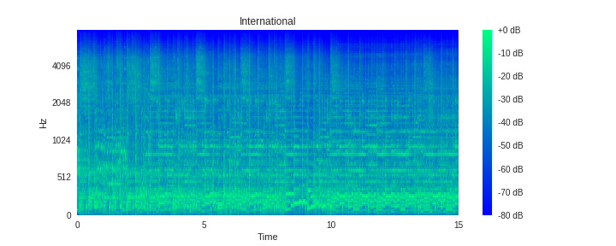
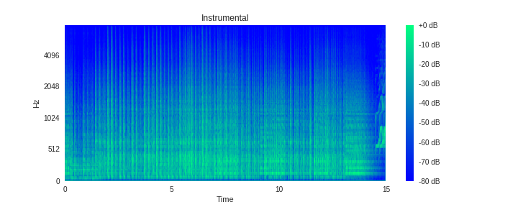

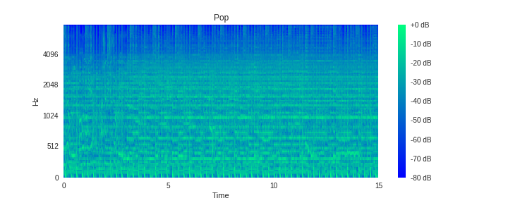
Mel spectrogram
Notes:
And this gave me the idea to use a CNN for image classification. But knowing that there was a time component to the mel-spectrograms I wanted to incorporate an RNN since they excel at understanding sequential data.

Slide 7

Data Preparation
Create spectrogram array using librosa
Convert decibel array to power array
Log scale
Target matrix as categorical
Notes:
To prepare my feature matrix, I converted my mp3 files to mel-spectrograms, converted the array from decibels to power, and then log scaled it. For my target values I simply turned them into a categorical matrix by one hot encoding the targets.

Slide 8
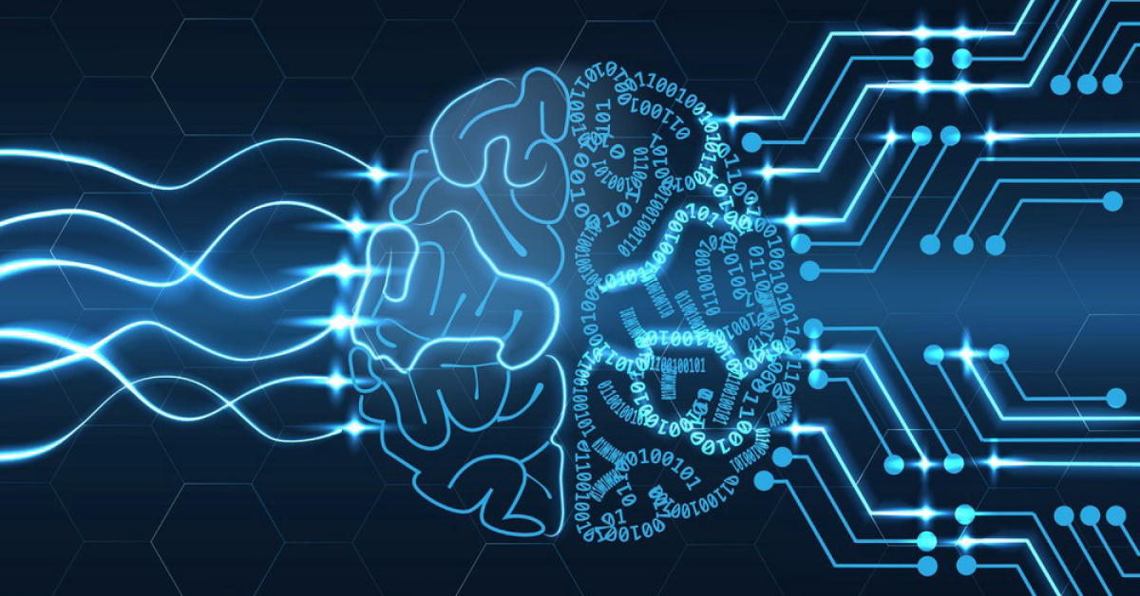
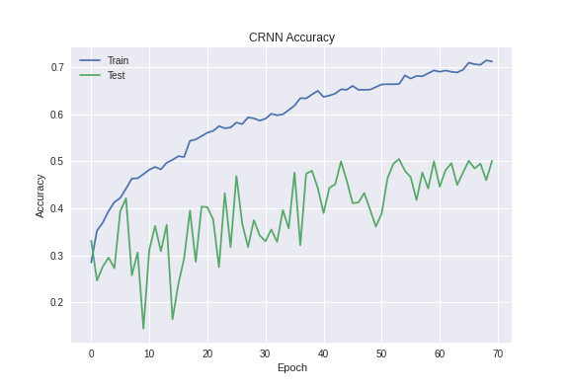
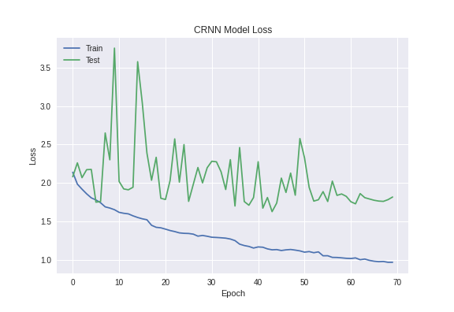
Convolutional recurrent neural network
Input
1D Convolution RELU
Batch Norm 1D
Maxpooling
LSTM
Output
Dense
Dense Softmax
3x
Notes:
My first model was a convolutional recurrent neural network that used 1D CNNs and an LSTM. Each 1D convolution layer extracted features from a small slice of the spectrogram, it applied RELU activation, then batch normalization, and lastly 1D Max Pooling to reduce dimensions and prevent over fitting. This chain of operations was performed 3 times and then its output was fed into an LSTM. The output from the LSTM was passed into a Dense Layer and then the final output layer was a dense layer with Softmax activation assigning probabilities to the 8 classes. This model gave me a 53% validation accuracy with its best weights.

Slide 9
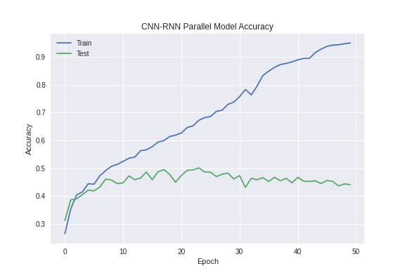
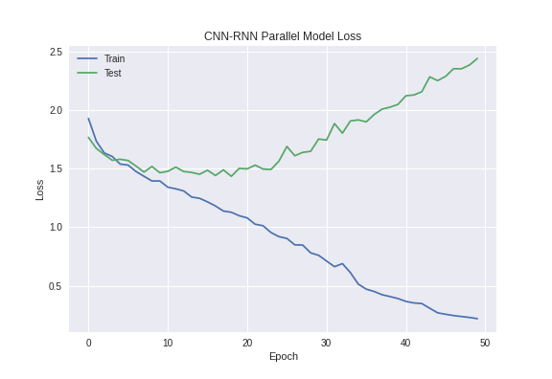
CNN – rnn in Parallel
Input
2D Convolution RELU 2D Maxpooling
Concatenate
Output
Dense Softmax
5x
2D Maxpooling Bi-Directional GRU
Notes:
The second model I tried was one that used a CNN and RNN in parallel. The convolutional block consisted of a 2D convolution layer followed by a 2D Maxpooling layer, for a total of 5 blocks of convolution max pooling layers before flattening the final output. The recurrent block started with 2D max pooling to reduce image size before sending it to a bidirectional GRU. The two resulting outputs were then concatenated before the final dense layer with Softmax activation. This model did about the same as the first with a 54% validation accuracy using its best weights.

Slide 10
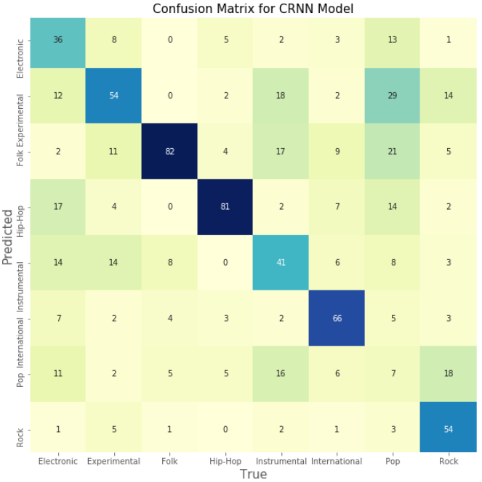
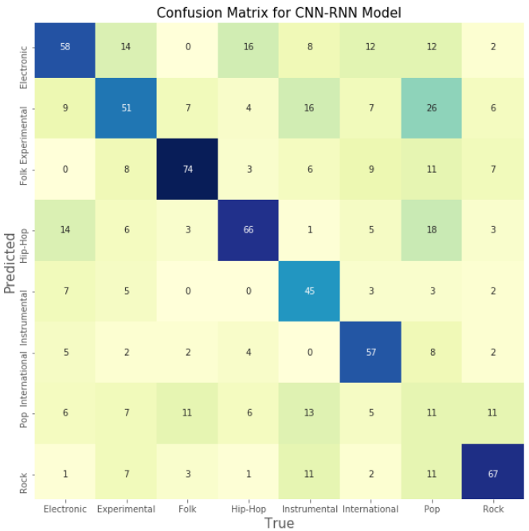
CRNN | cnn-rnn parallel
Notes:
The two models performed very similarly as far as overall accuracy but they did differ in class wise performance. The parallel CNN-RNN model had better performance for Electronic, Instrumental, Pop, and Rock.

Slide 11
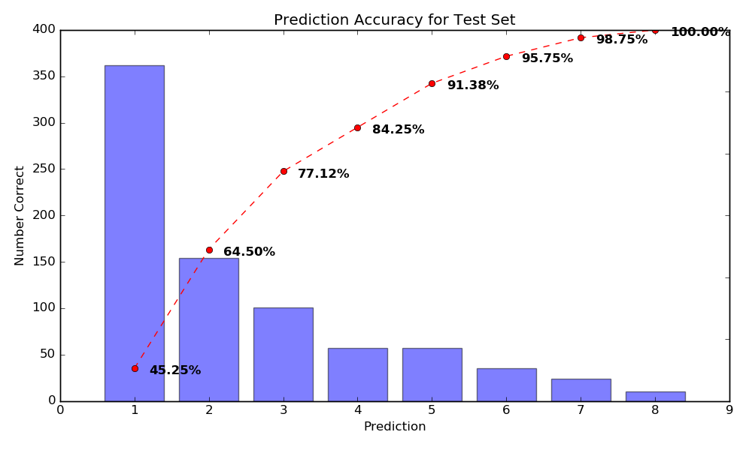
Accuracy
Top 2 accuracy for model 65%
Problematic genres / songs
FMA challenge top score only 63%
Notes:
All in all the accuracy was not very high, but when looking at top 2 or top 3 accuracy the results look much better with almost 80% for top 3 accuracy. This data set is challenging in that some of the genres could contain multiple genres within like say Pop. Additionally since the tracks were 30 second samples, most of what categorized the track as one genre could be left out. There is actually an FMA Genre Recognition challenge and the top leaderboard score only has an accuracy of around 63%.

Slide 12
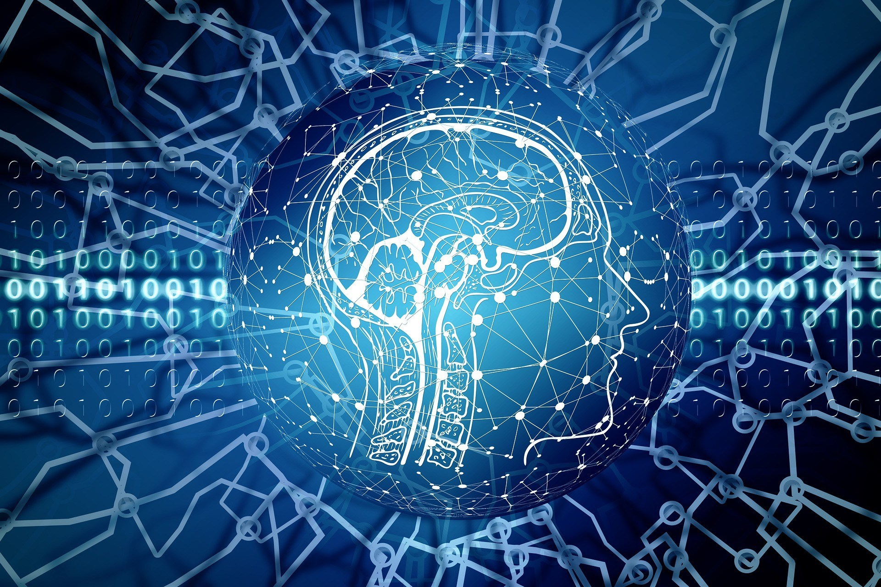

Human vs model – difficult tracks
Label | Track 1 | Track 2 | Track 3 | Track 4
True
Predicted
Dylan
Notes:
To illustrate some of the difficulties with the data I decided to use a human subject. Our resident Dylan, who is a trained audio engineer, kindly volunteered to guess on some of the tracks the model got incorrect. This was the first track:

Slide 13
Human vs model – difficult tracks
Label | Track 1 | Track 2 | Track 3 | Track 4
True | Folk
Predicted | Instrumental
Dylan | Experimental
Notes:
Dylan guessed Experimental, the model predicted Instrumental, and the correct label was Folk. Next:

Slide 14
Human vs model – difficult tracks
Label | Track 1 | Track 2 | Track 3 | Track 4
True | Folk | Instrumental
Predicted | Instrumental | Folk
Dylan | Experimental | Folk
Notes:
Dylan and my model both predicted folk, but the correct label was instrumental. Next track:

Slide 15
Human vs model – difficult tracks
Label | Track 1 | Track 2 | Track 3 | Track 4
True | Folk | Instrumental | Instrumental
Predicted | Instrumental | Folk | Experimental
Dylan | Experimental | Folk | Electronic
Notes:
Dylan guessed electronic, model predicted experimental, correct label was instrumental. And the last track:

Slide 16
Human vs model – difficult tracks
Label | Track 1 | Track 2 | Track 3 | Track 4
True | Folk | Instrumental | Instrumental | Pop
Predicted | Instrumental | Folk | Experimental | Experimental
Dylan | Experimental | Folk | Electronic | Hip-Hop
Notes:
Dylan guessed Hip-Hop, model predicted Experimental, correct label was Pop. So it seems like a human can’t really perform any better than the model does.

Slide 17

Future Steps
Ensemble model using both neural networks
Larger sample size
Access to full song might yield better results
Notes:
Some future steps to take would be to ensemble both of the neural networks since they had different class wise performance. And then using more than just 6400 songs to train on or even having it train on the entire song might lead to better results.

Slide 18
References
Data: https://github.com/mdeff/fma
Mel-Spectrogram: https://medium.com/@priya.dwivedi
CRNN: https://arxiv.org/pdf/1609.04243.pdf
CNN RNN Parallel: https://arxiv.org/abs/1712.08370
Notes:
And that is Audio Classification. Thank you all for your time.

Slide 19










David diaz-paez
Data Scientist
github.com/ddiaz164
linkedin.com/in/ddiaz164

